Slide 1
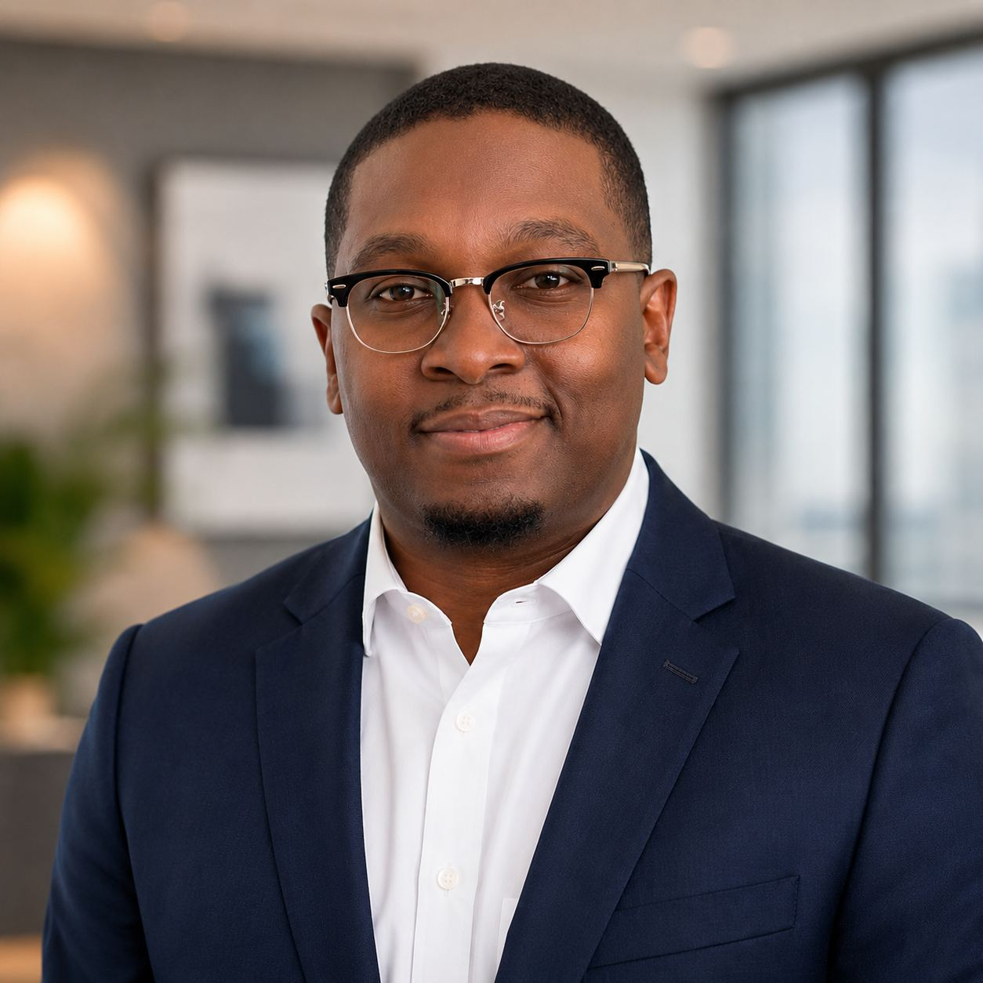
Twalib Mohamed
Building High-Performing Sales Teams Through Coaching, Accountability, and Execution
Market Development Supervisor, Residential Market Development
Great sales organizations are not built from dashboards. They are built in the field. My philosophy is simple: develop people, create accountability, and remove obstacles so teams can perform consistently.
20+
Team members developed
23.9%
Mobile attach rate
#2
Regional ranking, of 8
7+ yrs
Leading telecom sales
Twalib.tmo@gmail.com · 678-488-1074 · Atlanta, Georgia

Slide 2
ABOUT
Who I am
I have spent seven years in telecom sales, the last three leading a market development team of more than 20 people at Spectrum. Before that I sold B2B accounts myself, and before that I built enterprise technology deals at AT&T. So I have sat in every seat on this org chart.
What I do well comes down to three things. First, I lead by serving the team. My job is to clear what is in my reps' way, not to sit above them and ask for updates. Second, I coach off the data. I read the BI dashboards rep by rep every morning and go into each conversation with the one specific gap we are working on, so nothing I say is guesswork. Third, I empower people inside clear expectations. Everyone owns their territory and their day, and everyone knows exactly what the standard is, so they can make their own calls without waiting on me.

Slide 3
EXPERIENCE
Market Development Supervisor, Spectrum
March 2023 to Present
• Run sales execution for a team of more than 20 reps, including their targets, their weekly cadence, and their development.
• Own territory planning and forecasting for the market. I use unit density and past performance to decide where reps spend their time, and I keep the forecast honest enough that leadership can plan against it.
• Coach reps in the field every week. Ride alongs, same day feedback, and a specific skill focus per person rather than general advice.
• Work directly with Operations, Construction, Customer Care, Marketing, and Installation to get serviceability answers faster and keep installs on schedule.
• Rebuilt how the team tracks activity and pipeline so problems show up while there is still time to fix them.

Slide 4
EXPERIENCE
Business Sales Executive, Spectrum
May 2021 to March 2023
• Carried a full B2B cycle on my own: prospecting, discovery, proposal, negotiation, and close.
• Built relationships with owners and decision makers that turned one time sales into renewals and add on business.
• Designed connectivity and voice solutions around what the customer actually struggled with, not around what was easiest to quote.
• Kept my own pipeline and CRM clean, which is why my forecast was something my manager could rely on.
• Stayed involved after the signature, working with implementation so customers were live when we said they would be.

Slide 5
EXPERIENCE
Enterprise Technology Consultant (Sales Division), AT&T
September 2018 to May 2021
• Sold connectivity and managed technology to mid-market and enterprise customers.
• Ran discovery workshops with executive stakeholders to understand their operational and security problems before proposing anything.
• Partnered with Sales Engineers, Solution Architects, and Operations to design and deliver solutions that held up in production.
• Negotiated multi year agreements and renewals on business value instead of discounts.
• Built account plans that grew existing customers rather than chasing only new logos.

Slide 6
DAYS 1 TO 30
Listen first
Learn all six teams, the supervisors running them, and the real numbers before I change anything.
• Sit down one on one with each of the six supervisors. How they run their team, what they are good at, what is in their way, and what support looks like to them.
• Spend a day in the field with each team and ride along with reps so I see the work myself, not just the report.
• Read the numbers team by team and rep by rep: activity, connects, close rate, attach, and how close last quarter's forecast came to reality.
• Go through the CRM honestly with each supervisor: stage definitions, aging deals, and where the pipeline is not telling the truth.
• Write down the starting numbers for all six teams and share them so everyone sees the same baseline.
• Introduce myself to my counterparts in Construction, Operations, Marketing, Care and Installation before I need anything from them.
HOW YOU WOULD KNOW IT WORKED
• One on one done with all six supervisors
• Field day completed with every team
• Baseline numbers written down and shared

Slide 7
DAYS 31 TO 60
Protect what works, fix what is in the way
Keep what each team is already doing well, change only what is clearly slowing people down, and get one shared rhythm running across all six.
• Name what is already working on each team, the habits, the accounts and the people carrying it, and protect that before I change anything.
• Set one weekly rhythm the whole group runs: numbers on Monday, field time midweek, one on ones, and a weekly review with the six supervisors together.
• Coach the supervisors on coaching. I ride with them while they coach their own reps and give them the same day feedback I would give a rep.
• Tighten the forecast across all six teams. Clear stage criteria, rules for stale deals, and one place everyone looks.
• Get on the same page with Construction and Operations about serviceability, install timing, and who to call when something slips.
• Take proposed changes to my manager and to peer leaders for a second set of eyes before rolling anything out, instead of deciding alone.
HOW YOU WOULD KNOW IT WORKED
• One shared weekly rhythm running across all six teams
• Every supervisor coached in the field at least twice
• Forecast closer to actuals than the first 30 days
• Changes reviewed with leadership before rollout

Slide 8
DAYS 61 TO 90
Run it and prove it
Work the plan, show real movement, and make sure it keeps running without me in the room.
• Run the full weekly rhythm with one scorecard covering all six teams, visible to everyone.
• Hold every team to the same standard and work the gaps that are still there, team by team.
• Write down how we work, from first contact to the customer handoff, so a new supervisor or rep can pick it up.
• Give the strongest supervisors and reps something real to own so the next leader comes from inside the group.
• Show leadership what moved across the group: activity, connects, close rate and attach against the day one numbers.
• Bring a plan for the next two quarters with targets by team and territory.
HOW YOU WOULD KNOW IT WORKED
• Connects, close rate and attach up against day one across the six teams
• Playbook written and being used
• Next two quarters planned and presented

Slide 9
HOW I LEAD
My leadership operating system
PEOPLE
EXPECTATIONS
COACHING
ACCOUNTABILITY
EXECUTION
RESULTS
Hire and keep people who want to be coached, then serve them.
Written standards so nobody has to guess what good looks like.
In the field, same day, one gap at a time.
Everyone knows their number and where they stand this week.
A weekly rhythm the team runs without me in the room.
Pipeline, close rate and attach measured against day one.

Slide 10
HOW I LEAD
What that looks like day to day
Coaching that happens in the field
I ride along, I watch the conversation, and I give feedback the same day. Each rep works on one specific thing at a time instead of a list of general advice, and we check on it the following week.
Straight talk about performance
Everyone knows their number and where they stand. When someone slips I say so early, while it is still fixable, and when someone is carrying the team I make sure it is seen and rewarded.
Territories and forecasts I can defend
I plan coverage around unit density and real opportunity, and I keep the forecast honest even when the honest number is not the one anyone wants. Pipeline visibility is my job, not a chore I push down to reps.
Relationships across the other teams
I know the people in Operations, Construction, Care, Marketing, and Installation by name. That is why my escalations move and my reps are not left explaining a delay they had no part in.

Slide 11
HOW I LEAD
What that looks like day to day
Comfortable in the executive room
I have run discovery workshops with decision makers and negotiated multi year agreements on business value rather than price. I can put a rep in that room and coach them through it.
Small fixes, repeated
I do not rip up a process on day one. I find the handoff or the report that wastes an hour a week, fix it, write it down, and move to the next one.

Slide 12
LEADERSHIP PHILOSOPHY
How I actually operate
How I coach
I coach in the field, not from a desk. I ride along, listen at the door, and give feedback the same day while the call is still fresh. Each rep works one specific gap at a time and we check it the following week. Before any of those conversations I have already read their individual numbers, so what I say is grounded in their week, not my opinion.
How I make decisions
I start with the data and finish with the people. The BI dashboards tell me where to look; the rep tells me why. When something is unclear I go see it myself before deciding. And before I roll out a change I take it to my manager and a peer supervisor for a second set of eyes, because a decision made alone is a decision nobody else owns.
How I build trust
I do what I said I would do, and I do it first. My job is to clear what is in a rep's way, whether that is a serviceability answer, an install date or an escalation, not to sit above them asking for updates. I give credit in public and correction in private, and I never surprise anyone with feedback they should have heard a week earlier.

Slide 13
LEADERSHIP PHILOSOPHY
How I actually operate
How I handle conflict
Early and directly. Most conflict on a sales floor comes from an unclear expectation or a missed handoff, so I go find the facts before I go find fault. I have the hard conversation while it is still fixable, in person, and I leave it with a written plan and a date. Between departments I lean on relationships I built before I needed them.
How I measure success
Three ways. The numbers: connects, close rate, attach, penetration against day one. The people: who got promoted, who is ready next. And whether the rhythm keeps running when I am out. If the team only performs when I am standing there, I have built a dependency, not a system.
How I develop leaders
I give strong people something real to own, like a territory tier, a piece of the weekly meeting or a new hire to onboard, and then I let them make calls I would have made. I write down how we work so the knowledge is not in my head. The goal is that the next leader comes from inside the team.

Slide 14
SELECTED WINS
Building the Georgia team from nothing
THE SITUATION
The department was brand new in the GA market. There was no team, no rhythm, and no standard for what a day was supposed to look like.
WHAT I DID
I built the team from the ground up, set the expectations in writing, and put the daily and weekly rhythm in place: morning numbers, field time, one on ones, and a weekly review the department still runs on.
WHAT CHANGED
Every result the market has produced came out of a team and a cadence that did not exist before I built it.
20+
REPS LED

Slide 15
SELECTED WINS
Getting installs to keep up with sales
THE SITUATION
We were selling faster than Construction and Installation could deliver, and then city permits stalled projects outright, so serviceable inventory dried up mid-month.
WHAT I DID
I set up a standing working session with Operations, Construction, Care, Marketing, and Installation. Relationships I had built over years meant I heard about permit holds and delays early, so I re-cut territory assignments and moved reps onto live inventory instead of letting them sit.
WHAT CHANGED
We kept our momentum through the delays, installs moved faster, escalations dropped, and customers stopped hearing excuses from my reps.
5
TEAMS INVOLVED

Slide 16
SELECTED WINS
Turning transactional accounts into renewals
THE SITUATION
A set of mid market and enterprise accounts were being handled as one off sales with no executive relationship behind them.
WHAT I DID
I ran discovery workshops with the actual decision makers, built solutions around problems they told me about, and negotiated multi year terms.
WHAT CHANGED
Retention improved, accounts grew, and the recurring revenue base got bigger.
Full-cycle
B2B OWNERSHIP

Slide 17
SELECTED WINS
Coaching off the numbers every day
THE SITUATION
Coaching without data turns into opinion, and reps stop believing it.
WHAT I DID
I read the BI dashboards every morning, rep by rep, and decide from the individual numbers where each person needs work that day. I coach to that one gap, and I call out the wins in front of the team when the numbers move.
WHAT CHANGED
Everybody knows where they stand before I say a word, and the conversation is about one specific thing instead of a general lecture.
Daily
BI REVIEW

Slide 18
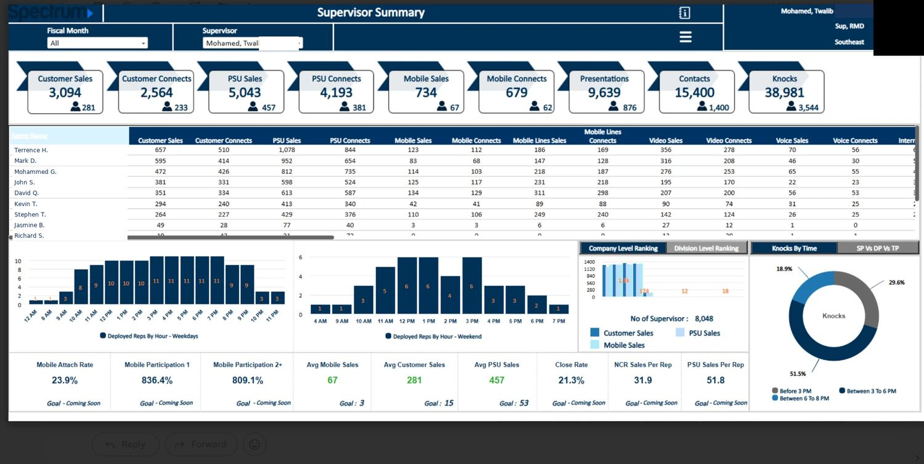
THE NUMBERS
My team, rep by rep
My team's fiscal year summary. I read this every morning and decide who needs what that day.

Slide 19
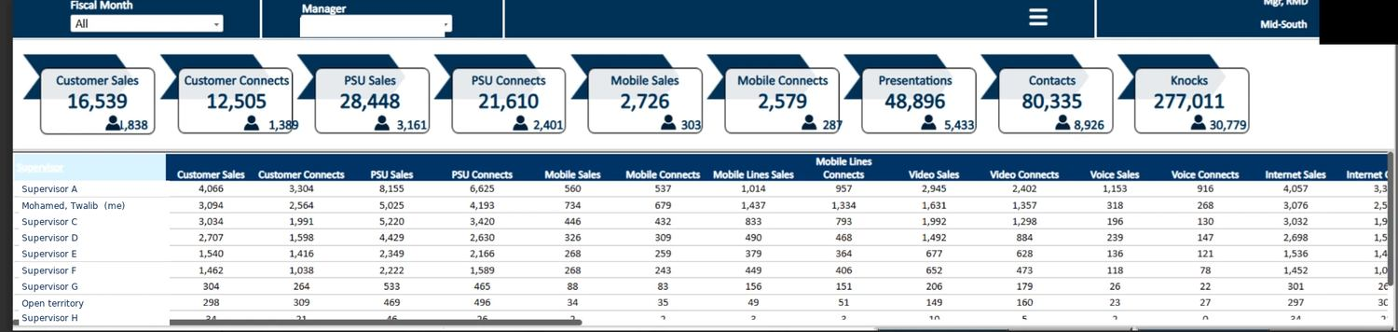
THE NUMBERS
Where we landed in the region
The same period across the region, my team second of eight.

Slide 20
HOW I COACH
Two conversations I have often
These are two real coaching notes I sent, shown as they went out. They cover the two situations that come up most: someone whose activity is short of the standard, and someone who is mid month and behind pace.

Slide 21
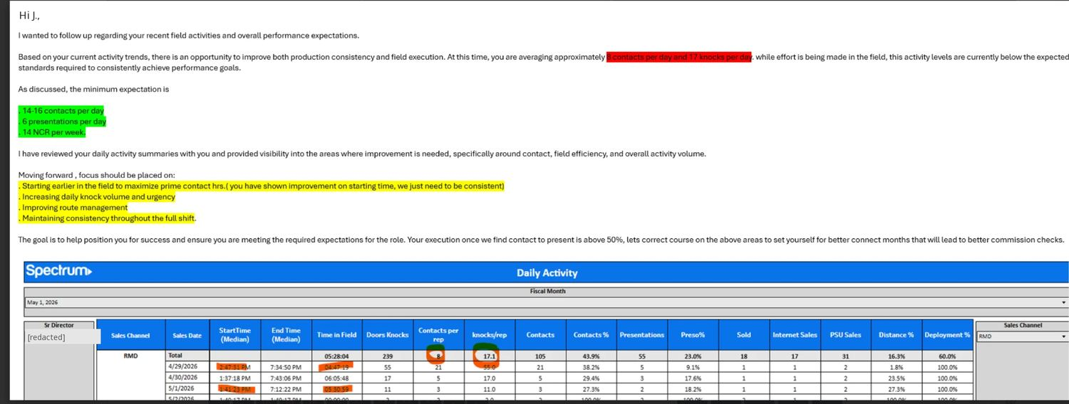
A REP BELOW THE ACTIVITY STANDARD
Subject: Field activity and where we go from here
The email as it went out. The standard is in writing and the behaviors to change are highlighted.

Slide 22
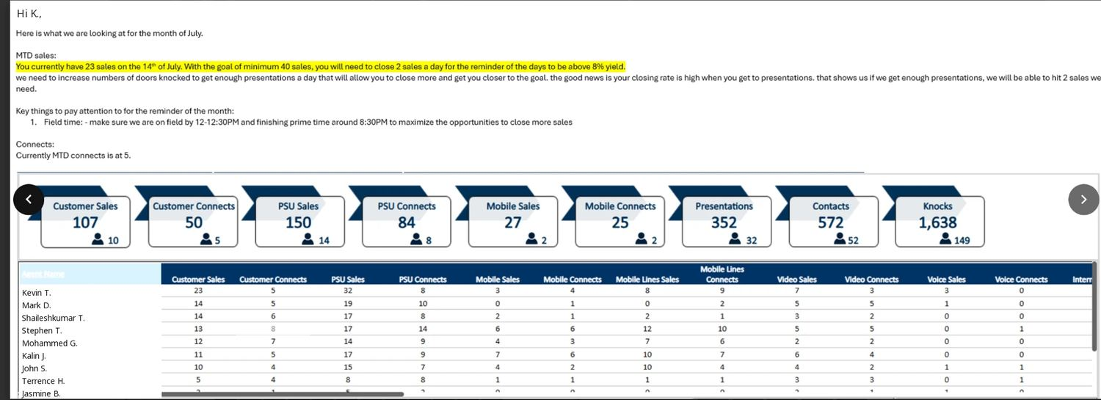
A REP MID-MONTH, BEHIND PACE
Subject: Where we are for July
Mid month check in: the math he needed to see, with the team ribbon and his rank underneath.

Slide 23
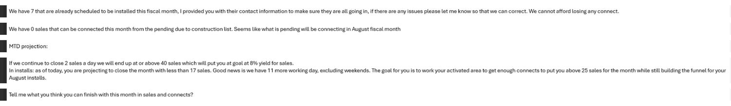
A REP MID-MONTH, BEHIND PACE
Subject: Where we are for July
The second half of the same email, the projection and the question I close on.

Slide 24
Let's talk
Twalib.tmo@gmail.com · 678-488-1074
Bachelor of Science, Business Administration, Kennesaw State University

